Slide 1
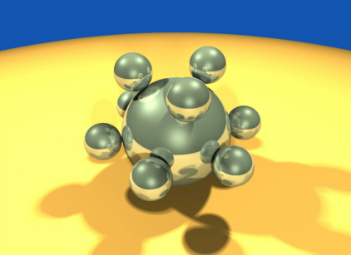
Computer Graphics using OpenGL,
3rd Edition
F. S. Hill, Jr. and S. Kelley
Chapter 2
Initial Steps in Drawing Figures
S. M. Lea
University of North Carolina at Greensboro
© 2007, Prentice Hall

Slide 2
Using Open-GL
Files: .h, .lib, .dll
  The entire folder gl is placed in the Include directory of Visual C++
  The individual lib files are placed in the lib directory of Visual C++
  The individual dll files are placed in C:\Windows\System32

Slide 3
Using Open-GL (2)
Includes:
  <windows.h>
  <gl/gl.h>
  <gl/glu.h>
  <gl/glut.h>
  <gl/glui.h> (if used)
Include in order given. If you use capital letters for any file or directory, use them in your include statement also.

Slide 4
Using Open-GL (3)
Changing project settings: Visual C++ 6.0
  Project menu, Settings entry
  In Object/library modules move to the end of the line and add glui32.lib glut32.lib glu32.lib opengl32.lib (separated by spaces from last entry and each other)
  In Project Options, scroll down to end of box and add same set of .lib files
  Close Project menu and save workspace

Slide 5
Using Open-GL (3)
Changing Project Settings: Visual C++ .NET 2003
  Project, Properties, Linker, Command Line
  In the white space at the bottom, add glui32.lib glut32.lib glu32.lib opengl32.lib
  Close Project menu and save your solution

Slide 6
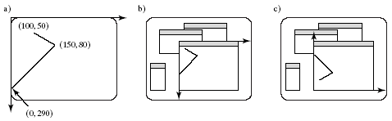
Getting Started Making Pictures
Graphics display: Entire screen (a); windows system (b); [both have usual screen coordinates, with y-axis down]; windows system [inverted coordinates] (c)

Slide 7
Basic System Drawing Commands
setPixel(x, y, color)
  Pixel at location (x, y) gets color specified by color
  Other names: putPixel(), SetPixel(), or drawPoint()
line(x1, y1, x2, y2)
  Draws a line between (x1, y1) and (x2, y2)
  Other names: drawLine() or Line().

Slide 8
Alternative Basic Drawing
current position (cp), specifies where the system is drawing now.
moveTo(x,y) moves the pen invisibly to the location (x, y) and then updates the current position to this position.
lineTo(x,y) draws a straight line from the current position to (x, y) and then updates the cp to (x, y).

Slide 9
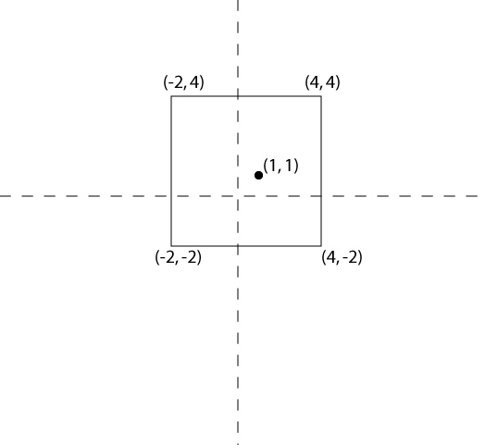
Example: A Square
moveTo(4, 4); //move to starting corner
lineTo(-2, 4);
lineTo(-2, -2);
lineTo(4, -2);
lineTo(4, 4); //close the square

Slide 10
Device Independent Graphics and OpenGL
Allows same graphics program to be run on many different machine types with nearly identical output.
  .dll files must be with program
OpenGL is an API: it controls whatever hardware you are using, and you use its functions instead of controlling the hardware directly.
OpenGL is open source (free).

Slide 11
Event-driven Programs
Respond to events, such as mouse click or move, key press, or window reshape or resize. System manages event queue.
Programmer provides “call-back” functions to handle each event.
Call-back functions must be registered with OpenGL to let it know which function handles which event.
Registering function does *not* call it!

Slide 12
Skeleton Event-driven Program
// include OpenGL libraries
void main()
{
glutDisplayFunc(myDisplay); // register the redraw function
glutReshapeFunc(myReshape); // register the reshape function
glutMouseFunc(myMouse); // register the mouse action function
glutMotionFunc(myMotionFunc); // register the mouse motion function
glutKeyboardFunc(myKeyboard); // register the keyboard action function
…perhaps initialize other things…
glutMainLoop(); // enter the unending main loop
}
…all of the callback functions are defined here

Slide 13
Callback Functions
glutDisplayFunc(myDisplay);
  (Re)draws screen when window opened or another window moved off it.
glutReshapeFunc(myReshape);
  Reports new window width and height for reshaped window. (Moving a window does not produce a reshape event.)
glutIdleFunc(myIdle);
  when nothing else is going on, simply redraws display using void myIdle() {glutPostRedisplay();}

Slide 14
Callback Functions (2)
glutMouseFunc(myMouse);
  Handles mouse button presses. Knows mouse location and nature of button (up or down and which button).
glutMotionFunc(myMotionFunc);
  Handles case when the mouse is moved with one or more mouse buttons pressed.

Slide 15
Callback Functions (3)
glutPassiveMotionFunc(myPassiveMotionFunc)
  Handles case where mouse enters the window with no buttons pressed.
glutKeyboardFunc(myKeyboardFunc);
  Handles key presses and releases. Knows which key was pressed and mouse location.
glutMainLoop()
  Runs forever waiting for an event. When one occurs, it is handled by the appropriate callback function.

Slide 16
Libraries to Include
GL, for which the commands begin with GL;
GLUT, the GL Utility Toolkit, opens windows, develops menus, and manages events.
GLU, the GL Utility Library, which provides high level routines to handle complex mathematical and drawing operations.
GLUI, the User Interface Library, which is completely integrated with the GLUT library.
  The GLUT functions must be available for GLUI to operate properly.
  GLUI provides sophisticated controls and menus to OpenGL applications.

Slide 17
A GL Program to Open a Window
// appropriate #includes go here – see Appendix 1
void main(int argc, char** argv)
{
glutInit(&argc, argv); // initialize the toolkit
glutInitDisplayMode(GLUT_SINGLE | GLUT_RGB); // set the display mode
glutInitWindowSize(640,480); // set window size
glutInitWindowPosition(100, 150);
// set window upper left corner position on screen
glutCreateWindow("my first attempt");
// open the screen window (Title: my first attempt)
// continued next slide

Slide 18
Part 2 of Window Program
// register the callback functions
glutDisplayFunc(myDisplay);
glutReshapeFunc(myReshape);
glutMouseFunc(myMouse);
glutKeyboardFunc(myKeyboard);
myInit(); // additional initializations as necessary
glutMainLoop(); // go into a perpetual loop
}
Terminate program by closing window(s) it is using.

Slide 19
What the Code Does
glutInit (&argc, argv) initializes Open-GL Toolkit
glutInitDisplayMode (GLUT_SINGLE | GLUT_RGB) allocates a single display buffer and uses colors to draw
glutInitWindowSize (640, 480) makes the window 640 pixels wide by 480 pixels high

Slide 20
What the Code Does (2)
glutInitWindowPosition (100, 150) puts upper left window corner at position 100 pixels from left edge and 150 pixels down from top edge
glutCreateWindow (“my first attempt”) opens and displays the window with the title “my first attempt”
Remaining functions register callbacks

Slide 21
What the Code Does (3)
The call-back functions you write are registered, and then the program enters an endless loop, waiting for events to occur.
When an event occurs, GL calls the relevant handler function.

Slide 22
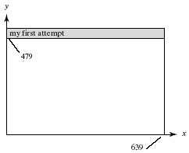
Effect of Program

Slide 23
Drawing Dots in OpenGL
We start with a coordinate system based on the window just created: 0 to 679 in x and 0 to 479 in y.
OpenGL drawing is based on vertices (corners). To draw an object in OpenGL, you pass it a list of vertices.
  The list starts with glBegin(arg); and ends with glEnd();
  Arg determines what is drawn.
  glEnd() sends drawing data down the OpenGL pipeline.

Slide 24
OpenGL configuration for Dev C++
Download GLUT files from http://chortle.ccsu.edu/Bloodshed/glutming.zip
Extract and get the files
Glut.h
libglut32.a
glut32.dll

Slide 25
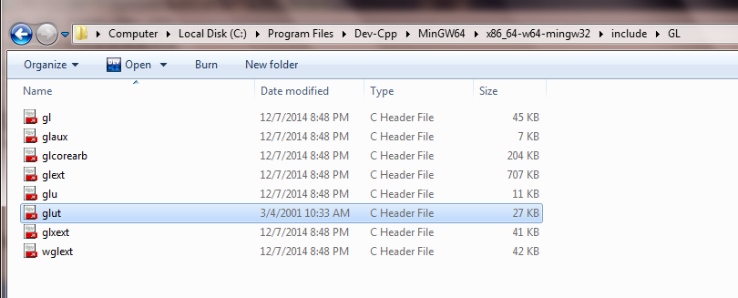
Glut.h
Copy this file to the following folder
"../../Dev-Cpp/MinGW64/x86_64-w64-mingw32/include/GL/Glut.h“

Slide 26
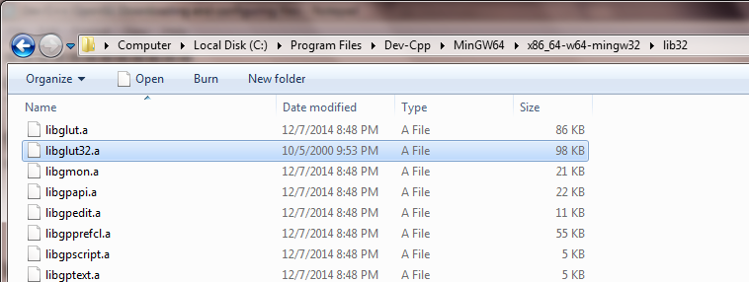
libglut32.a
Copy the libglut32.a file to the folder
"../..Dev-Cpp/MinGW64/x86_64-w64-mingw32/lib32/libglut32.a"

Slide 27
glut32.dll
Copy the glut32.dll file to the folders
(force overwrite)
C:/../windows/System32
and
C:/../windows/System

Slide 28
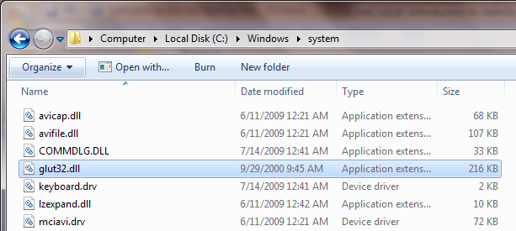
Copying glut32.dll (1)

Slide 29
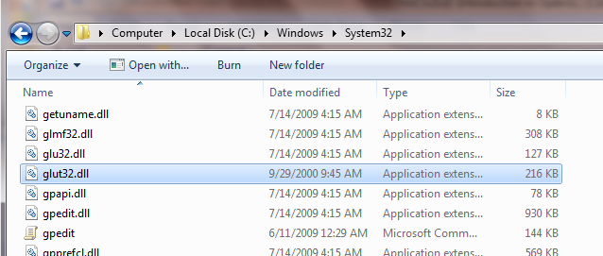
Copying glut32.dll (2)

Slide 30
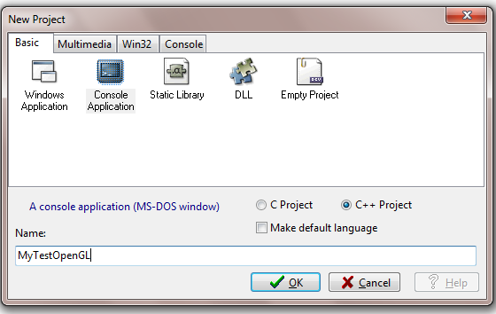
Start a a new dev C/C++ Empty Project

Slide 31
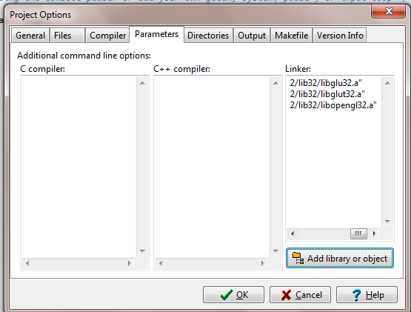
Adding libraries
Select Project Options>>Parameters
>>Add library or object

Slide 32
Adding libraries
Use this option to add the following the libraries from
../Dev-Cpp/MinGW64/x86_64-w64-mingw32/lib32/ folder (see the next slide)
ibopengl32.a
libglu32.a
libglut32.a

Slide 33
Click OK to save settings

Slide 34
Running Sample Program
Compile and Run the attached program, SimpleDots.cpp

Slide 35
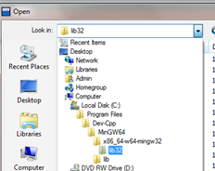
Selecting Lib32 folder

Slide 36
Example
glBegin (GL_POINTS);
  glVertex2i (100, 50);
  glVertex2i (100, 130);
  glVertex2i (150, 130);
glEnd();
GL_POINTS is constant built-into Open-GL (also GL_LINES, GL_POLYGON, …)
Complete code to draw the 3 dots is in Fig. 2.11.

Slide 37
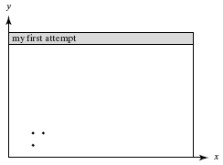
Display for Dots

Slide 38

What Code Does: GL Function Construction

Slide 39
Example of Construction
glVertex2i (…) takes integer values
glVertex2d (…) takes floating point values
OpenGL has its own data types to make graphics device-independent
  Use these types instead of standard ones

Slide 40
Open-GL Data Types
suffix | data type | C/C++ type | OpenGL type name
b | 8-bit integer | signed char | GLbyte
s | 16-bit integer | Short | GLshort
i | 32-bit integer | int or long | GLint, GLsizei
f | 32-bit float | Float | GLfloat, GLclampf
d | 64-bit float | Double | GLdouble,GLclampd
ub | 8-bit unsigned number | unsigned char | GLubyte,GLboolean
us | 16-bit unsigned number | unsigned short | GLushort
ui | 32-bit unsigned number | unsigned int or unsigned long | GLuint,Glenum,GLbitfield

Slide 41
Setting Drawing Colors in GL
glColor3f(red, green, blue);
// set drawing color
  glColor3f(1.0, 0.0, 0.0); // red
  glColor3f(0.0, 1.0, 0.0); // green
  glColor3f(0.0, 0.0, 1.0); // blue
  glColor3f(0.0, 0.0, 0.0); // black
  glColor3f(1.0, 1.0, 1.0); // bright white
  glColor3f(1.0, 1.0, 0.0); // bright yellow
  glColor3f(1.0, 0.0, 1.0); // magenta

Slide 42
Setting Background Color in GL
glClearColor (red, green, blue, alpha);
  Sets background color.
  Alpha is degree of transparency; use 0.0 for now.
glClear(GL_COLOR_BUFFER_BIT);
  clears window to background color

Slide 43
Setting Up a Coordinate System
void myInit(void)
{
glMatrixMode(GL_PROJECTION);
glLoadIdentity();
gluOrtho2D(0, 640.0, 0, 480.0);
}
// sets up coordinate system for window from (0,0) to (679, 479)

Slide 44
Drawing Lines
glBegin (GL_LINES); //draws one line
  glVertex2i (40, 100); // between 2 vertices
  glVertex2i (202, 96);
glEnd ();
glFlush();
If more than two vertices are specified between glBegin(GL_LINES) and glEnd() they are taken in pairs, and a separate line is drawn between each pair.

Slide 45

Line Attributes
Color, thickness, stippling.
glColor3f() sets color.
glLineWidth(4.0) sets thickness. The default thickness is 1.0.
a). thin lines b). thick lines c). stippled lines

Slide 46
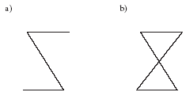
Setting Line Parameters
Polylines and Polygons: lists of vertices.
Polygons are closed (right); polylines need not be closed (left).

Slide 47
Polyline/Polygon Drawing
glBegin (GL_LINE_STRIP);
// GL_LINE_LOOP to close polyline (make it a polygon)
  // glVertex2i () calls go here
glEnd ();
glFlush ();
A GL_LINE_LOOP cannot be filled with color

Slide 48
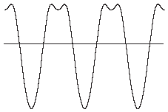
Examples
Drawing line graphs: connect each pair of (x, f(x)) values
Must scale and shift

Slide 49
Examples (2)
Drawing polyline from vertices in a file
  # polylines
  # vertices in first polyline
  Coordinates of vertices, x y, one pair per line
  Repeat last 2 lines as necessary
File for dinosaur available from Web site
Code to draw polylines/polygons in Fig. 2.24.

Slide 50
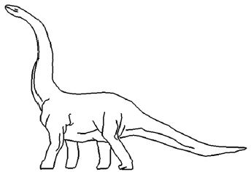
Examples (3)

Slide 51
Examples (4)
Parameterizing Drawings: allows making them different sizes and aspect ratios
Code for a parameterized house is in Fig. 2.27.

Slide 52
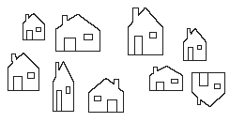
Examples (5)

Slide 53
Examples (6)
Polyline Drawing
Code to set up an array of vertices is in Fig. 2.29.
Code to draw the polyline is in Fig. 2.30.

Slide 54
Relative Line Drawing
Requires keeping track of current position on screen (CP).
moveTo(x, y); set CP to (x, y)
lineTo(x, y); draw a line from CP to (x, y), and then update CP to (x, y).
Code is in Fig. 2.31.
Caution! CP is a global variable, and therefore vulnerable to tampering from instructions at other points in your program.

Slide 55
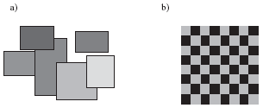
Drawing Aligned Rectangles
glRecti (GLint x₁, GLint y₁, GLint x₂, GLint y₂); // opposite corners; filled with current color; later rectangles are drawn on top of previous ones

Slide 56
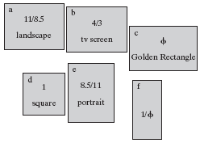
Aspect Ratio of Aligned Rectangles
Aspect ratio = width/height

Slide 57
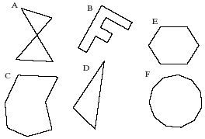
Filling Polygons with Color
Polygons must be convex: any line from one boundary to another lies inside the polygon; below, only D, E, F are convex

Slide 58
Filling Polygons with Color (2)
glBegin (GL_POLYGON);
  //glVertex2f (…); calls go here
glEnd ();
Polygon is filled with the current drawing color

Slide 59
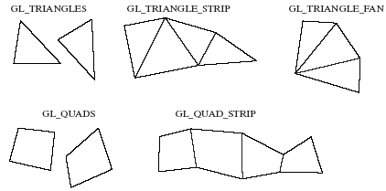
Other Graphics Primitives
GL_TRIANGLES, GL_TRIANGLE_STRIP, GL_TRIANGLE_FAN
GL_QUADS, GL_QUAD_STRIP

Slide 60
Simple User Interaction with Mouse and Keyboard
Register functions:
  glutMouseFunc (myMouse);
  glutKeyboardFunc (myKeyboard);
Write the function(s)
NOTE that any drawing you do when you use these functions must be done IN the mouse or keyboard function (or in a function called from within mouse or keyboard callback functions).

Slide 61
Example Mouse Function
void myMouse(int button, int state, int x, int y);
Button is one of GLUT_LEFT_BUTTON, GLUT_MIDDLE_BUTTON, or GLUT_RIGHT_BUTTON.
State is GLUT_UP or GLUT_DOWN.
X and y are mouse position at the time of the event.

Slide 62
Example Mouse Function (2)
The x value is the number of pixels from the left of the window.
The y value is the number of pixels down from the top of the window.
In order to see the effects of some activity of the mouse or keyboard, the mouse or keyboard handler must call either myDisplay() or glutPostRedisplay().
Code for an example myMouse() is in Fig. 2.40.

Slide 63
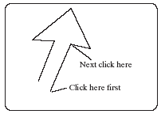
Polyline Control with Mouse
Example use:

Slide 64
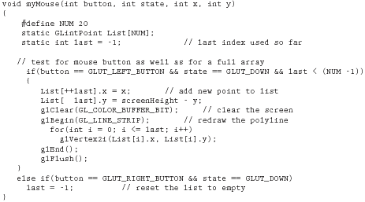
Code for Mouse-controlled Polyline

Slide 65
Using Mouse Motion Functions
glutMotionFunc(myMovedMouse); // moved with button held down
glutPassiveMotionFunc(myMovedMouse); // moved with buttons up
myMovedMouse(int x, int y); x and y are the position of the mouse when the event occurred.
Code for drawing rubber rectangles using these functions is in Fig. 2.41.

Slide 66
Example Keyboard Function
void myKeyboard(unsigned char theKey, int mouseX, int mouseY)
{
GLint x = mouseX;
GLint y = screenHeight - mouseY; // flip y value switch(theKey)
{case ‘p’: drawDot(x, y); break;
// draw dot at mouse position
case ‘E’: exit(-1); //terminate the program
default: break; // do nothing
}
}

Slide 67
Example Keyboard Function (2)
Parameters to the function will always be (unsigned char key, int mouseX, int mouseY).
The y coordinate needs to be flipped by subtracting it from screenHeight.
Body is a switch with cases to handle active keys (key value is ASCII code).
Remember to end each case with a break!

Slide 68
Using Menus
Both GLUT and GLUI make menus available.
GLUT menus are simple, and GLUI menus are more powerful.
We will build a single menu that will allow the user to change the color of a triangle, which is undulating back and forth as the application proceeds.

Slide 69
GLUT Menu Callback Function
Int glutCreateMenu(myMenu); returns menu ID
void myMenu(int num); //handles choice num
void glutAddMenuEntry(char* name, int value); // value used in myMenu switch to handle choice
void glutAttachMenu(int button); // one of GLUT_RIGHT_BUTTON, GLUT_MIDDLE_BUTTON, or GLUT_LEFT_BUTTON
  Usually GLUT_RIGHT_BUTTON

Slide 70
GLUT subMenus
Create a subMenu first, using menu commands, then add it to main menu.
  A submenu pops up when a main menu item is selected.
glutAddSubMenu (char* name, int menuID); // menuID is the value returned by glutCreateMenu when the submenu was created
Complete code for a GLUT Menu application is in Fig. 2.44. (No submenus are used.)

Slide 71
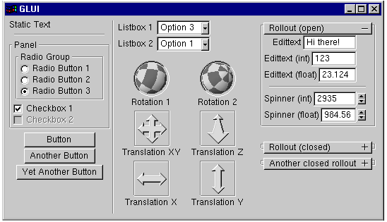
GLUI Interfaces and Menus

Slide 72
GLUI Interfaces
An example program illustrating how to use GLUI interface options is available on book web site.
Most of the work has been done for you; you may cut and paste from the example programs in the GLUI distribution.

